Slide 1

Biddib
Mahir Tekin Erdensan
Rumeysa Kutlu
Abdullah Burhan Başaran
Supervisor
Dr. Mustafa Bıçakcı

Slide 2



Subjects
Introduction
Purpose of the Project
Problem and Solution Statement
Analysis and Modeling
Project Design
Summary

Slide 3
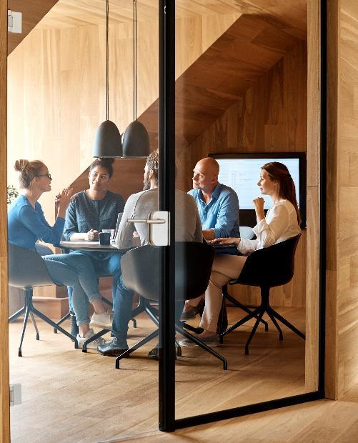



Introduction
In this presentation, we will talk about the plans, technologies, system designs and operation of the application necessary for the development of the application.

Slide 4

Purpose of Project
What is the aim of the project?
Why do we need Biddib application?

Slide 5
Purpose of the Project
Our app aims to give people the opportunity to purchase items they want safely through auctions and to provide financial benefits through selling products they don't need at a price that is possibly higher than their value.

Slide 6
Why Biddib?
Alt Başlık
Our website is fast and reliable.
Convenient and easy to use.
Accessibility.
User-to-user communication.

Slide 7
Problem and Solution Statement
Problems
Solutions offered by the Project

Slide 8
Problems
SECUrıty
Fraud
ShIll bIddIng
Web services and applications have affected the exchange of information, so web applications that allow multiple transactions are vulnerable to attacks because they contain multiple important data and different information.
Some malware can be used to reveal the personal information of the users participating in the auction. This may affect the reliability of the application.
The increasing popularity of using online auctions has led to an increase in fraudulent activity.
Once a buyer wins an auction and pays for it, the fraudulent seller will either not pursue with the delivery or send a less valuable version of the purchased item.
Placing fake bids that benefits the seller of the item is known as shill bidding. This is a method often used in online auction. This is seen as an unlawful act as it unfairly raises the final price of the auction, so that the winning bidder pays more than they should have.

Slide 9
Solutions offered by the Project
Security threats With OWASP (Open Web Application Security Project), authentication tokens are usually sent over the network and stored on both the front-end and back-end. This ensures a high level of security.
The confidentiality factor among the auction participants is considered by our application, which ensures its reliability. Our app uses 256-bit SSL encryption to prevent malware like SQL injection from trying to expose user information.
Another important feature of the online auction application is that the user enters private information such as Tc ID number, phone number and e-mail while becoming a member, and prevents fraud and fraud through identity verification.

Slide 10
Analysis and Modeling
System Architecture
Database Design
Class Diagrams

Slide 11
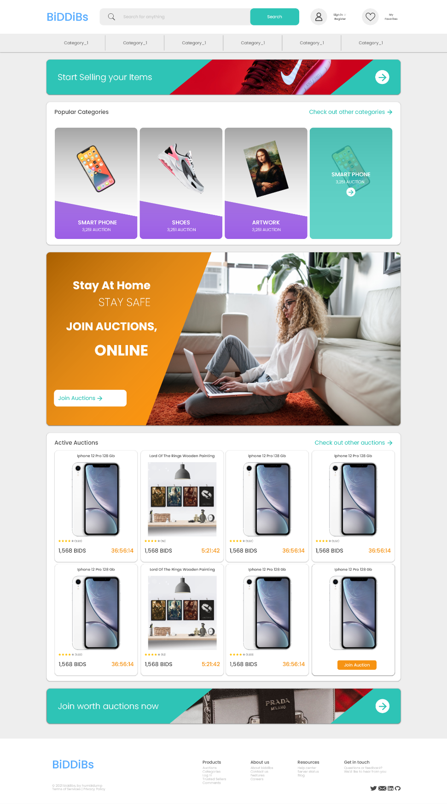
System Architecture
Front-end ArchItectures
In this part, we will provide you with information about the development of the front-end architecture presented to the user in our application.

Slide 12
Front-End Architectures
Development Environment | Visual Studio Code
Add-ons | Live Server, JavaScript (ES6) code snippets
Interface Design | Lunacy
Programming Languages | HTML5, CSS3, JavaScript, SASS, Django

Slide 13
System Architecture
Back-end ArchItectures
In this section, we will detail our system API that provides communication between the front-end and back-end of our application.

Slide 14
Back-End Architectures
Development Environment | Visual Studio Code
Programming Language | Python, Django
Database | MySQL

Slide 15
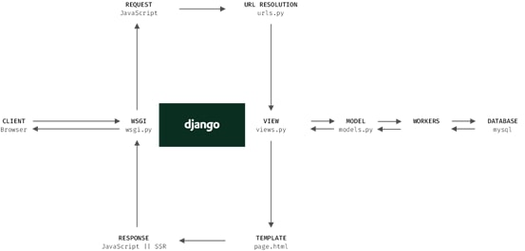
System Architecture
Back-end ArchItectures
Django is built on MVT(Model-View-Template) architecture model. We can examine MVT in 3 layers:
•Model – This layer works towards data processing.
•View – In MVT design pattern, the View is deciding what data should be displayed.
•Template - Templates is the layer that shows how to transfer data to users with help of templates.

Slide 16
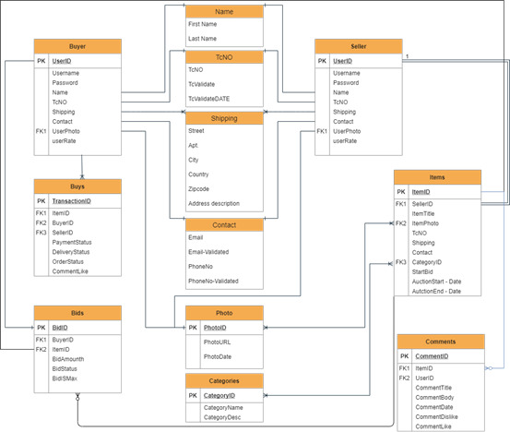
Database Design
We will detail our database design in this section, considering the future requirements of our online auction application.

Slide 17
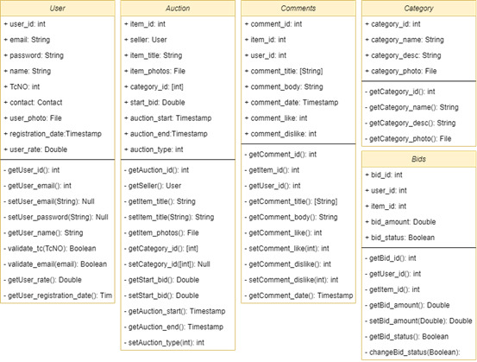
Class Diagrams

Slide 18
Project Design
Indroduction
User Interface

Slide 19
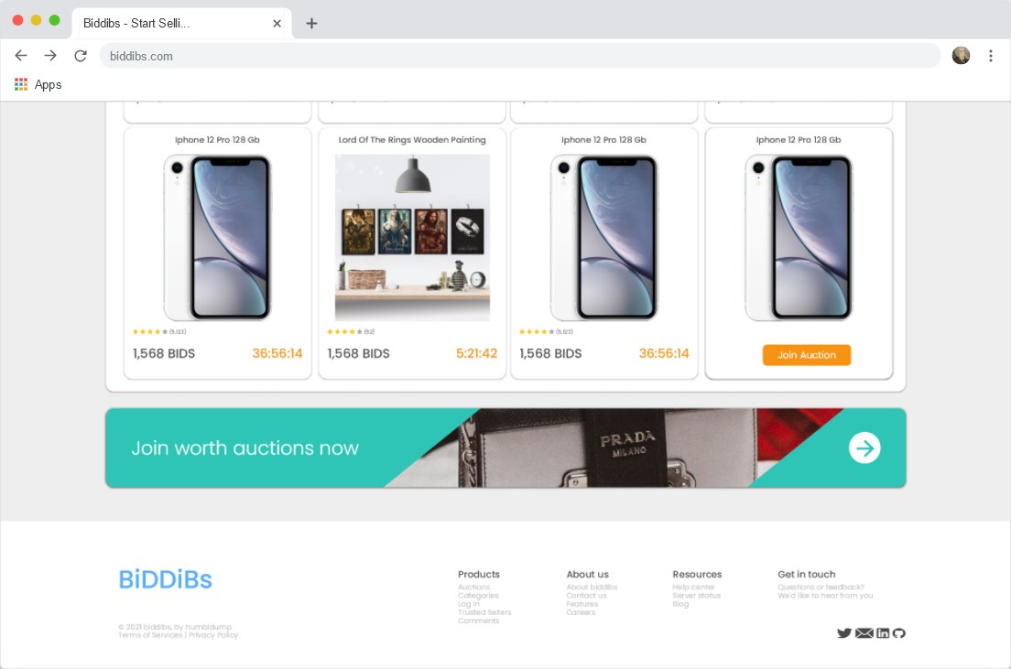
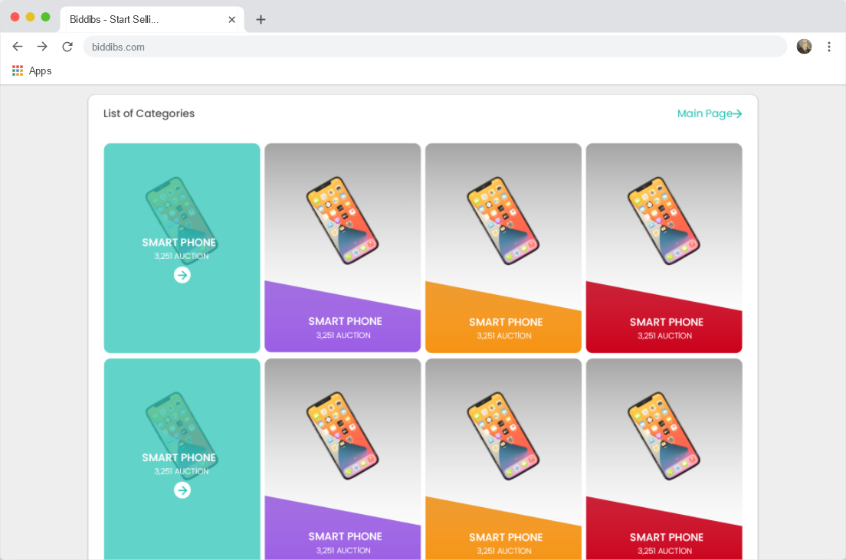
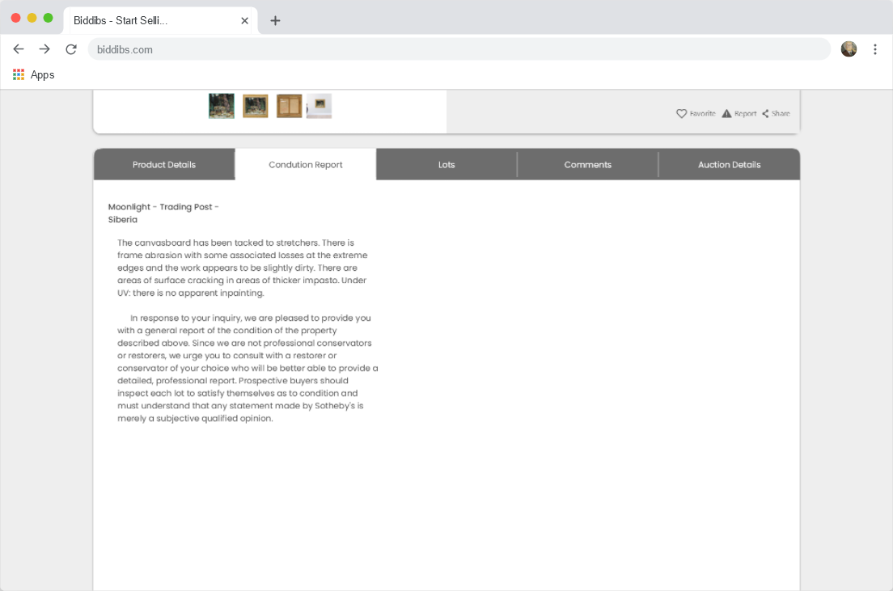
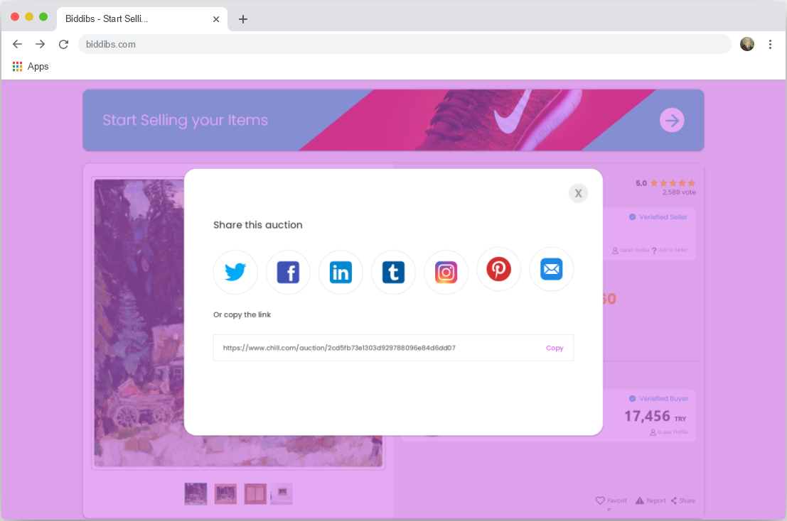
Indroduction
We have chosen a minimalist and user-friendly design to enhance our users' experience in our online auction application. In this section, we will introduce our design to you with mockups.

Slide 20
User Interface
HOme page
As the user first accesses our application, they will encounter with the “home page”. Home page of application is dynamic and generated especially for each user.

Slide 21
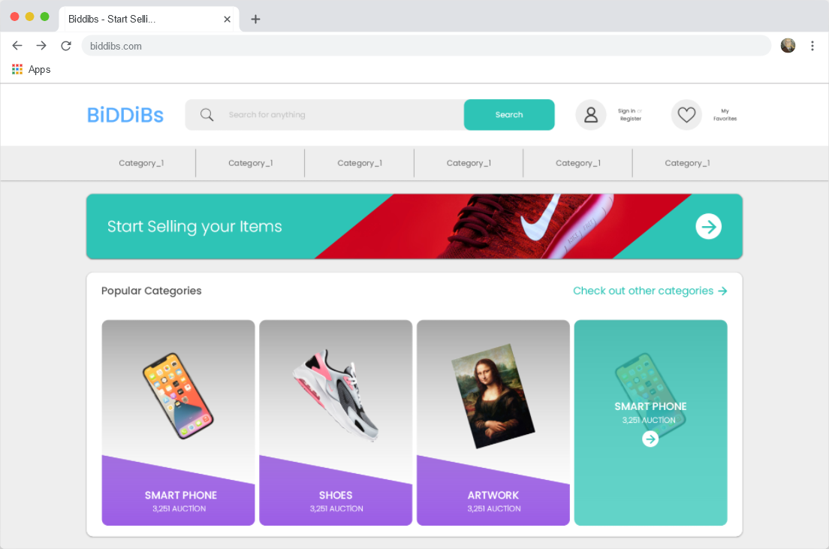
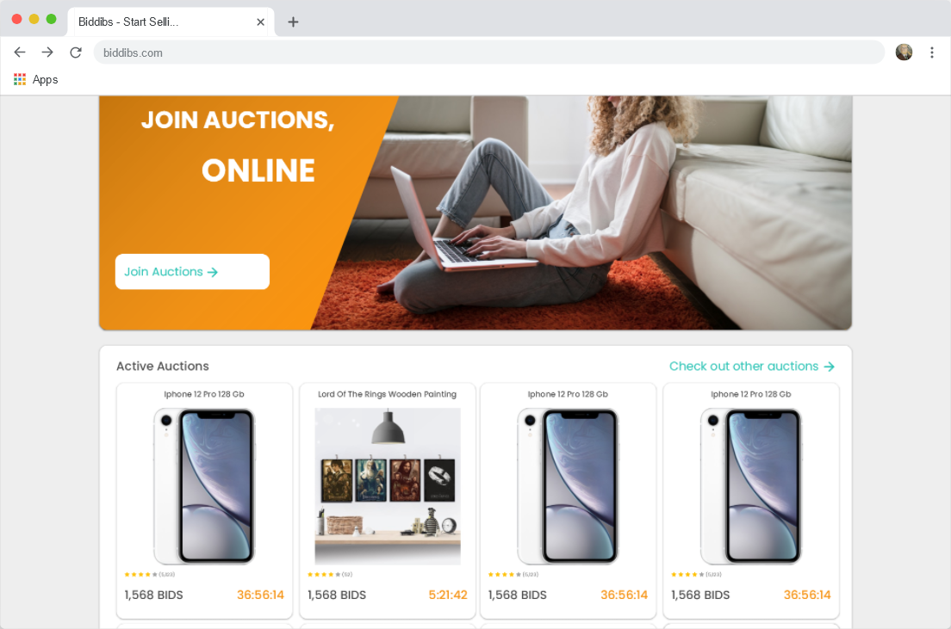
User Interface
Head Part of Home Page
Middle Part of Home Page
End of Home Page

Slide 22
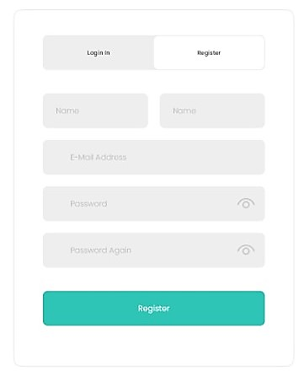
User Interface
Regıster page
In order for users to have certain privileges, they must first register on the registration page. Users need to enter 5 information that we will specify in order to register.

Slide 23
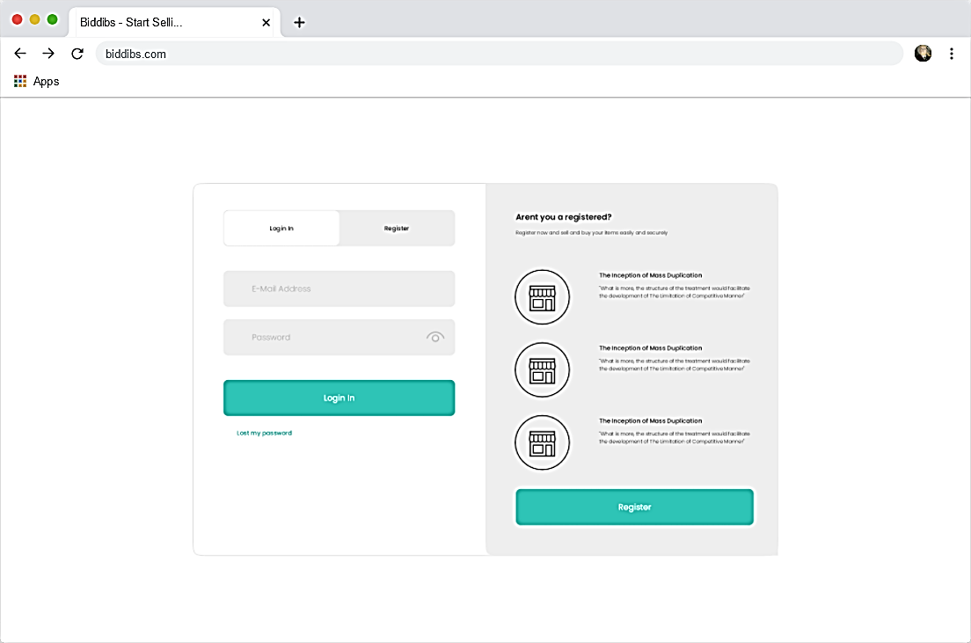
User Interface
User Logın page
On this page, the system welcomes users who are not registered or logged in with two sections:
In the section on the right, if the user has not registered, there is a card that explains why he/she should register and provides quick access to the registration page.
On the left, there are 2 sections that allow entering the necessary information to identify the user.

Slide 24
User Interface
List of Categories Page
On the list of categories page, there is a list of all categories set by the admin.

Slide 25
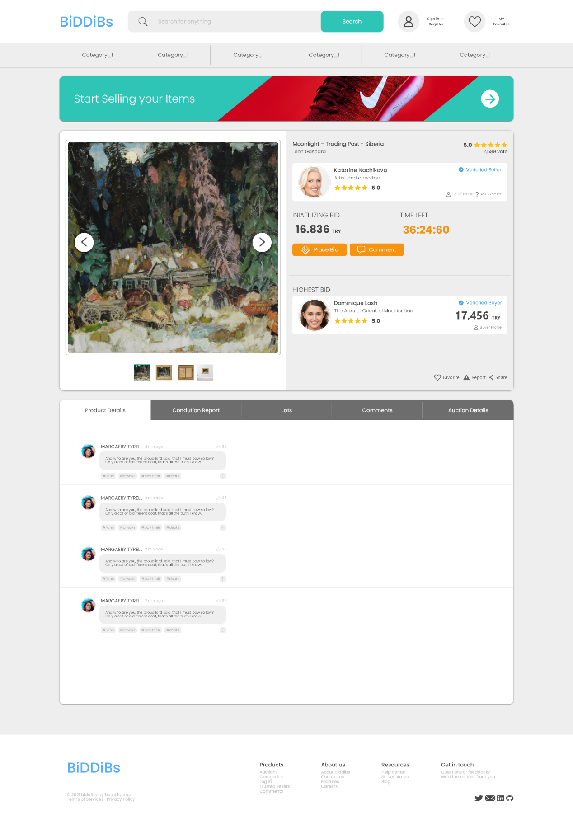
User Interface
AuctIon ProfIle Page
This page contains sections for promoting a major auction and for the user to participate in that auction.

Slide 26
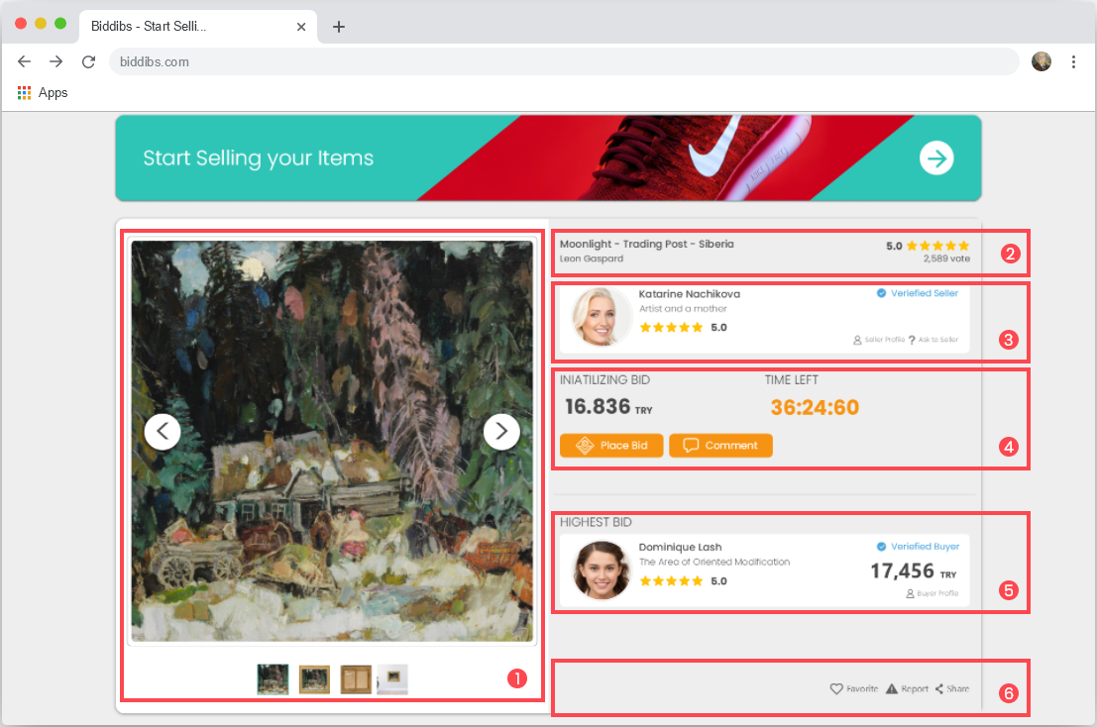
User Interface
Auction Profile Main Section
We can examine this section as 6 parts:
Product Pictures
Product Title
Seller Information’s
Auction Information’s
Highest Bid
Bottom Menu

Slide 27
User Interface
Share thıs actıon menu
The user can share the auction they want to share on the social media platforms.

Slide 28
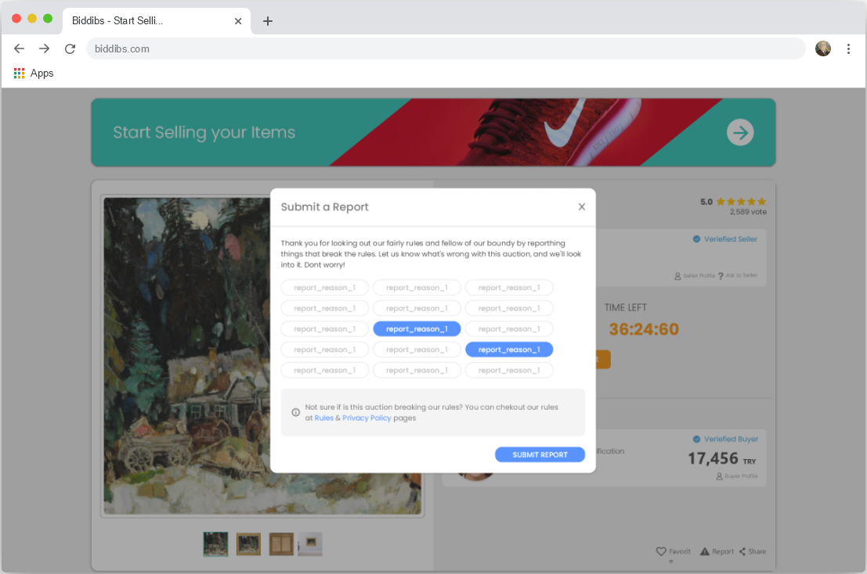
User Interface
Report This Auction Menu
In this menu, the user can report an auction that he/she finds inappropriate or inaccurate.

Slide 29
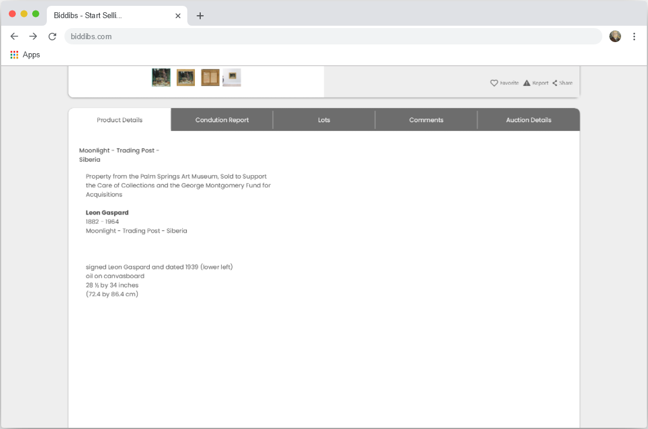
User Interface
Product Description Section
Product Condition Report Section

Slide 30
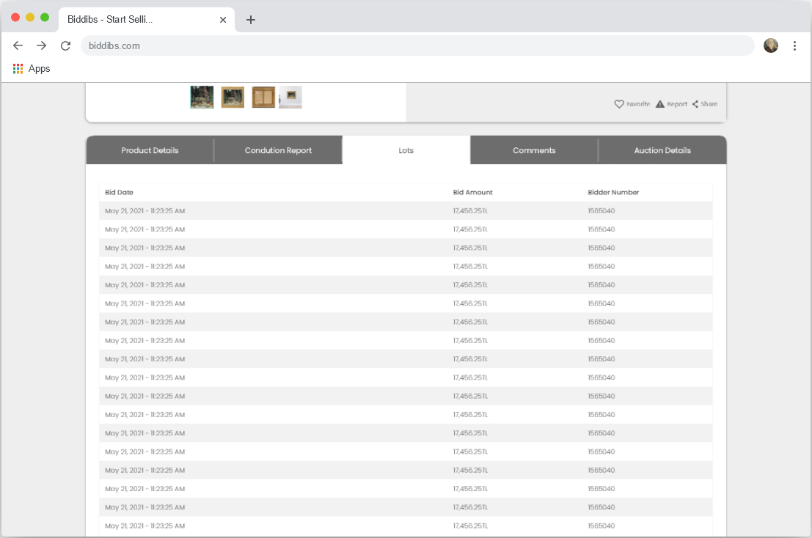
User Interface
Recent Bids for Auction Section
Final bids for the auction; The bidding date is displayed in this section along with the bid amount and the bidder's user number.

Slide 31
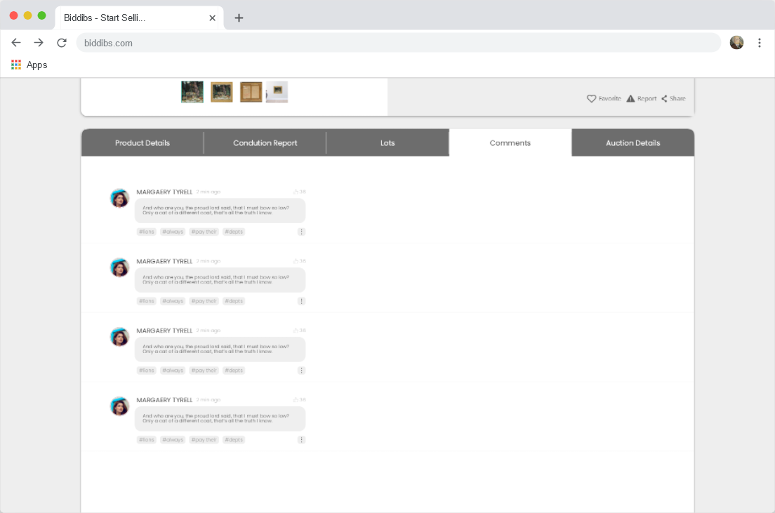
User Interface
Recent Comments for Auction Section
This section provides lists of the last comments submitted for an auction.

Slide 32
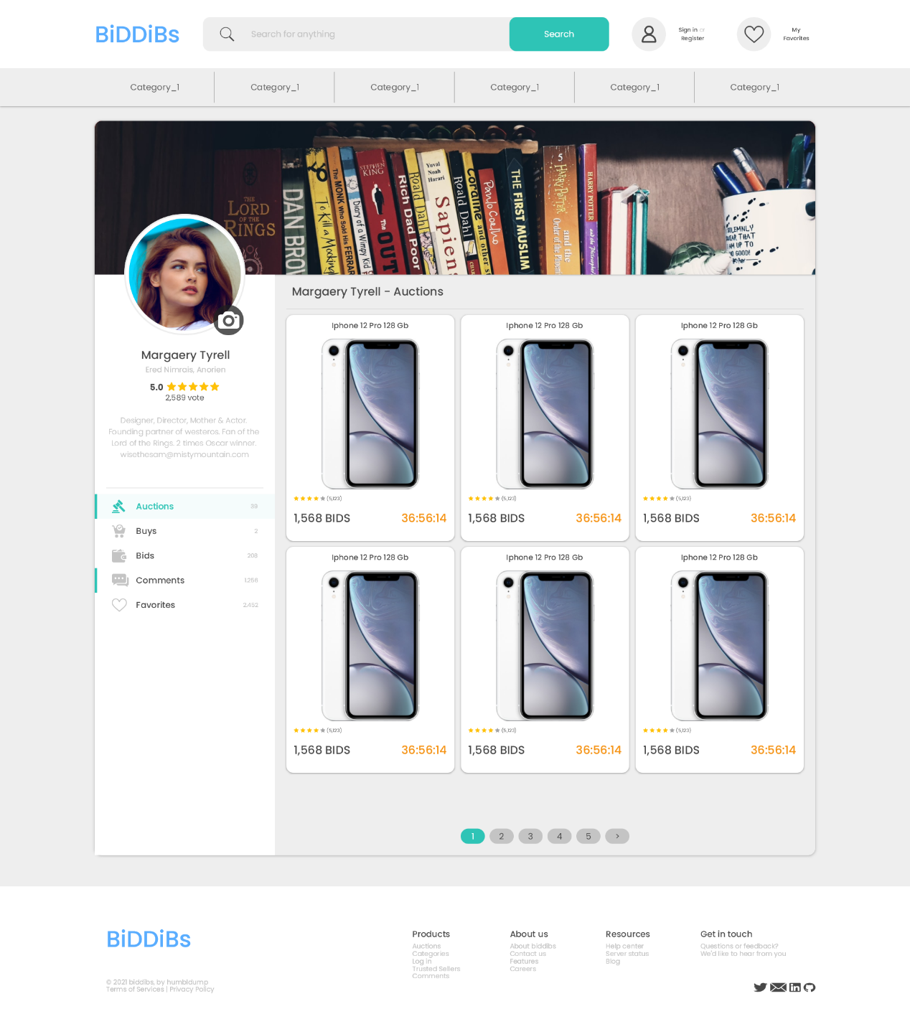
User Interface
User Profile Page
Each registered user has a unique profile page.

Slide 33
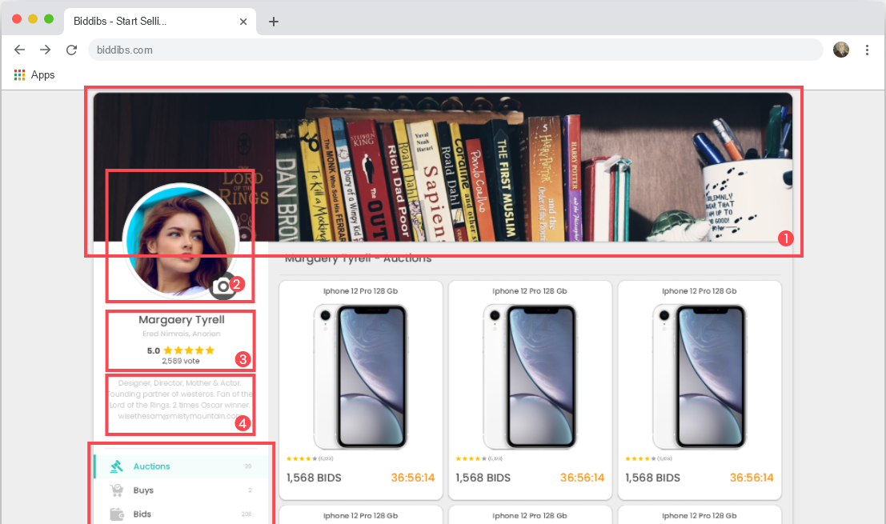
User Interface
User Profile Main Section
A user’s profile consists of the following 5 main sections:
Cover Page
Profile Picture
User Information’s
User Description
User Menu

Slide 34

Summary
Online auction is an application where all collectors, users who want to collect collections and users who want to sell their belongings can participate in auctions without difficulty and sell their desired product in secure auction sessions.

Slide 35


Thanks
Mahir Tekin Erdensan
Rumeysa Kutlu
Abdullah Burhan Başaran

